Slide 1

Medicare 101: The Basics
(Insert presenter’s name and title)
(Insert presenter’s contact information – optional)

Slide 2

For Virtual Presentations
Thank you for joining today’s presentation.
You are automatically muted and your camera is turned off.
You will see and hear the host and presenters.
Please ask questions via the Chat Box.
Please type names of anyone who is watching with you.
Please complete the survey at the end – thank you!
Notes:
ONLY FOR USE WHEN CONDUCTING VIRTUAL PRESENTATIONS.
Please delete this slide if conducting an in-person presentation.

Slide 3
What is Medicare?
Federally-funded individual health insurance program that provides coverage for medically-necessary procedures, services, medical supplies and equipment

Slide 4
Who is Eligible?
Anyone age 65 or older who participates in Social Security or the
Railroad Retirement System
Employees of Federal, State or Local Governments, or those whose
spouse has participated
Individuals who are under age 65 who have been awarded Social Security or
Railroad Retirement Disability after 24 months
Those who are disabled due to ALS (Lou Gehrig’s Disease)
Individuals with End-Stage Renal Disease (ESRD)

Slide 5
Administration and Enrollment
Medicare is administered by the Centers for Medicare and
Medicaid Services (CMS)
CMS is a branch of the Department of Health and Human
Services (DHHS)
The Social Security Administration (SSA) is responsible for
Medicare eligibility and enrollment
Notes:
Presenter: You may want to discuss the different logos for each entity listed above, so participants are aware of them when receiving mail.
IE: Apple for State Health Plan

Slide 6
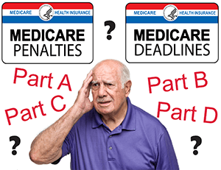
Do I Need to Enroll into Medicare Part A and Part B (“Original Medicare”)?

Slide 7
Automatic Enrollment
If turning 65 and collecting Social Security or Railroad Retirement Board benefits, prior to turning 65:
Coverage will begin on the first day of your 65th birth month, unless your birthday is the first day of the
month - in this case, coverage begins the first day of the preceding month
If under age 65 and collecting Social Security disability for 24 continuous months:
Coverage will begin on the first day of the 25th month
If eligible for Medicare due to ALS (Lou Gehrig’s Disease):
Coverage will begin the first day of the month that your disability benefits begin
Beneficiary will receive Original Medicare (red/white/blue) card in the mail, as well as the “Get Ready for Medicare” packet (CMS publication 11095)
Beneficiary has the option to decline Part B coverage by returning the card to Social Security
(NOTE: You may want to contact Social Security, Medicare, or SHIIP – before declining Part B – to discuss a possible Part B Late-Enrollment Penalty)

Slide 8
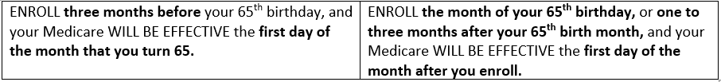
Initial Enrollment Period (IEP)
If turning 65, and not collecting Social Security Retirement benefits (you are not automatically enrolled)
Seven-month period to enroll into Original Medicare without penalty: three months
before, the month of, and three months after your 65th birth month:
(NOTE: If your birthday is on the first day of the month, your Medicare coverage begins on the first day of the prior month)

Slide 9
General Enrollment Period (GEP)
For those who do not qualify for Automatic Enrollment, and who do not enroll during their Medicare Initial Enrollment Period, there is another opportunity to enroll each year
Begins January 1st and ends March 31st
Enrollments during this period will have a delay in coverage, and a Late-Enrollment Penalty (LEP) may apply
  When you sign up during the General Enrollment Period, your Medicare coverage starts the first day of the month after you sign up
  10% Part B premium penalty, for one’s lifetime, for each 12-month period without Part B coverage

Slide 10
Special Enrollment Period (SEP)
If you didn’t enroll in Part B (or Part A, if you have to buy it) when you were first eligible because you had an Employer Group Health Plan (EGHP) based on current employment, you can sign up for Medicare Part A and/or Part B:
  After your Initial Enrollment Period is over
  Anytime you’re still covered by the EGHP
  During the eight-month period that begins the month after the employment ends, or the EGHP ends, whichever happens first
If you enroll in Medicare Part A and/or Part B during an SEP, the Part B LEP will not apply (NOTE: Forms CMS-40B and CMS-L564 will need to be completed and submitted to SSA.)
Speak to your HR Benefits Officer to discuss whether your EGHP or Medicare will be primary.
There may be other circumstances where you may be able to enroll in Medicare during a SEP
(NOTE: You should enroll in Medicare - before losing your EGHP - to avoid gaps in coverage. You do not qualify for this SEP if you are in your IEP.)

Slide 11
How Do I Enroll in Medicare Part A and Part B?
Medicare entitlement, eligibility and enrollment is handled by the Social Security Administration(SSA)
  Can be completed online at www.ssa.gov
  (You must create a socialsecurity.gov account – Username and
  Password)
  Call 1-800-772-1213 (Monday through Friday, 7AM to 7PM)
  Appointments can also be made for local offices through the
  toll-free number listed above

Slide 12
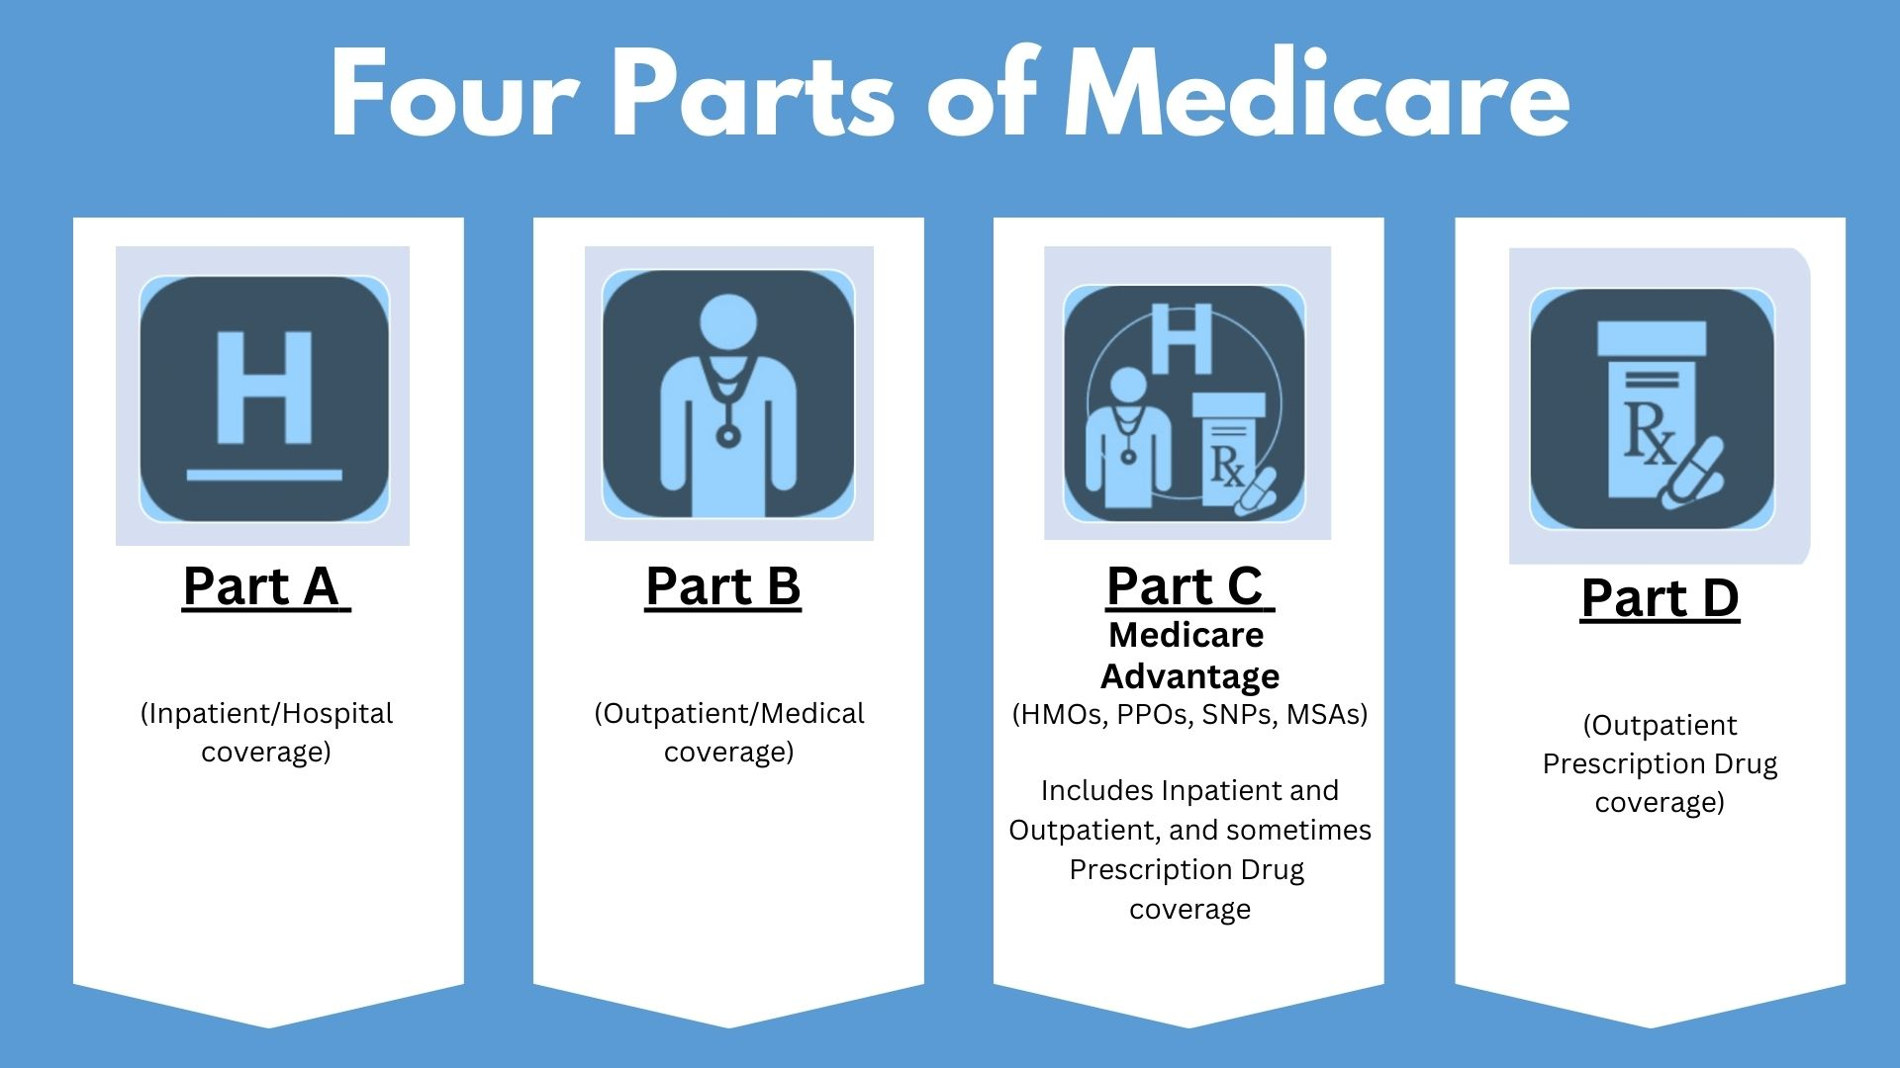

Slide 13
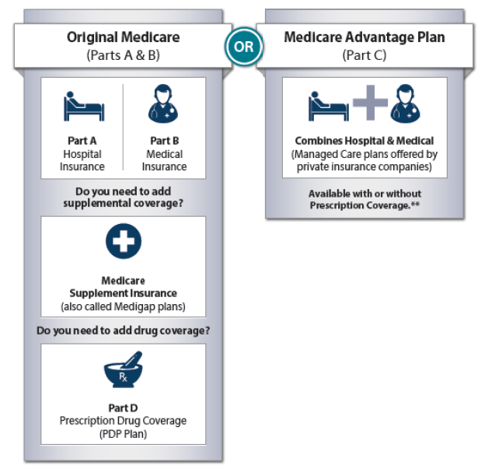
Your Medicare Coverage Choices

Slide 14
Your Medicare Coverage Choices

Slide 15
What Does Original Medicare Cover?
Medicare Part A
Medicare Part B
Inpatient Hospital Coverage
Skilled Nursing Care in a facility (requires a minimum three-day prior hospitalization)
Home Health Care
Hospice
Blood
Outpatient Hospital Coverage
Physician Services
Outpatient Surgery and Services
Durable Medical Equipment (DME), prosthetics, orthotics and supplies
Home Health Care
Preventative Services
Blood
Medicare benefits are administered by the Centers for Medicare and Medicaid Services (CMS)

Slide 16
What Is NOT Covered by Original Medicare?
Outpatient Prescription Medications
Routine Dental Care
Routine Vision Care and Eyeglasses
Hearing Aids
Foreign Travel
Cosmetic Procedures and Treatments
Long Term Care

Slide 17
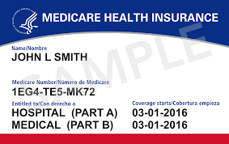
Medicare Part A and Part B

Slide 18
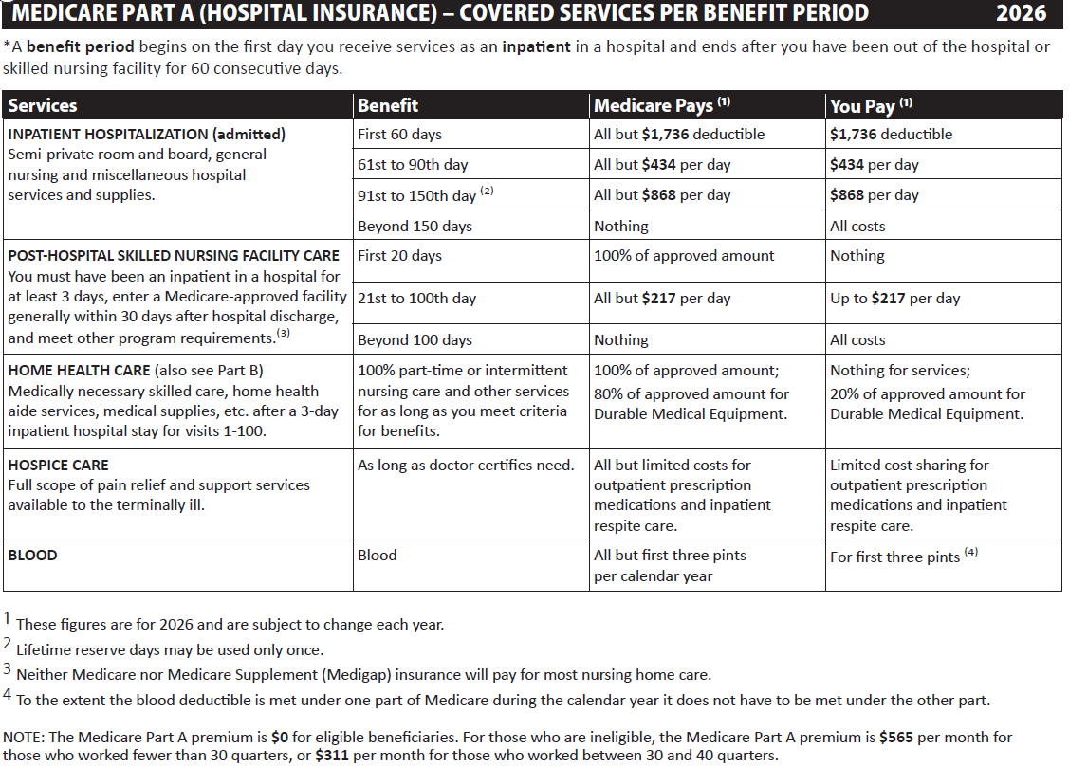
Notes:
The coinsurance and copayment amounts can and do change annually.

Slide 19
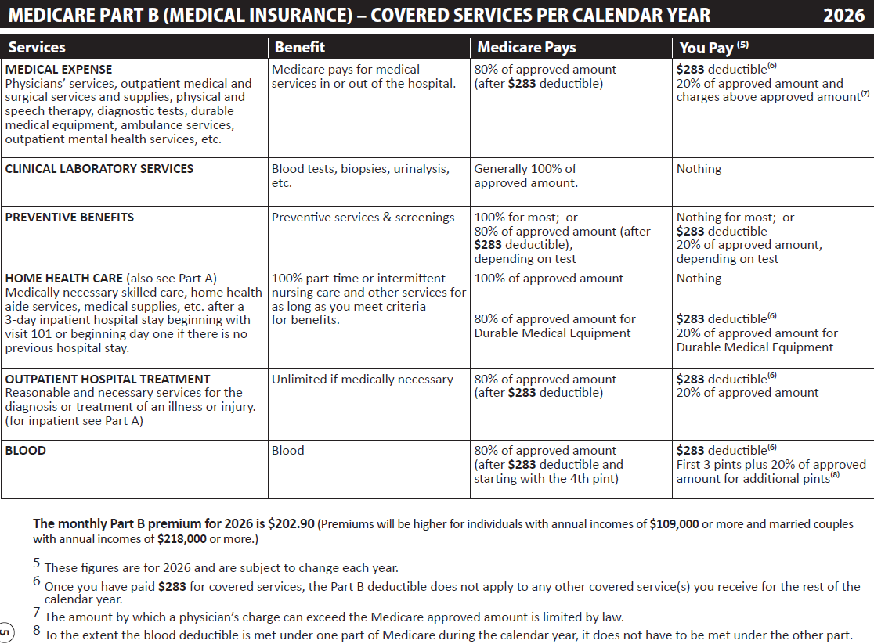
Notes:
The coinsurance and copayment amounts can and do change annually.

Slide 20
Part B Immunosuppressive Drug Coverage Only
Certain Medicare enrollees who are 36 months post kidney transplant, and therefore are no longer eligible for full Medicare coverage, can elect to continue Part B coverage of immunosuppressive drugs by paying a premium.
For 2026, the immunosuppressive drug premium is $121.60 per month.

Slide 21
Medicare Supplement (Medigap Plans)
Nationally standardized insurance plans designed to fill the “gaps” in
Original Medicare coverage (deductibles, copayments, coinsurance, etc.)
Plans are designated by letters (A, B, C, D, F, G, K, L, M, and N).
  Plans C, F, and F-Prime are only available to individuals who were eligible for Medicare prior to January 1, 2020
All plans cover a basic group of benefits, with each plan covering a
different group of benefits
Plan coverage is the same, from company to company, but premiums do vary
This presentation does not address how Medicare works with other
insurance coverage, such as EGHPs (active and retiree), COBRA, TriCare or
VA benefits

Slide 22
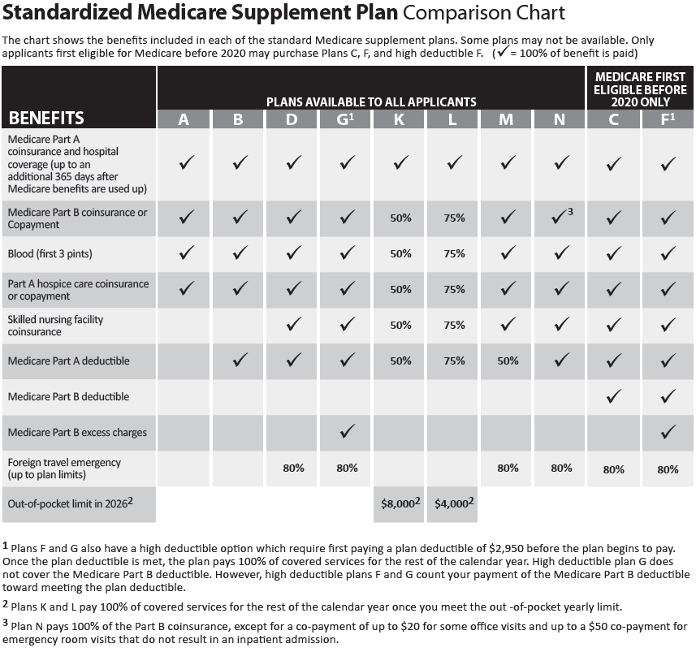

Slide 23
Medicare Prescription Drug Coverage – Part D
Anyone covered by Medicare Part A and/or Part B is eligible to
purchase a Medicare Prescription Drug Plan (PDP)
PDPs are sold by private insurance companies that are contracted with
CMS, and many require payment of monthly premiums
Each PDP covers a group of prescription medications (formulary)
  Annual deductible may need to be satisfied
  Copayments may apply to prescription medications
Plans/coverage, pharmacy networks and formularies may change annually,
effective January 1st
  Compare your Medicare PDP each year - during the Medicare Open Enrollment Period (OEP), which is October 15th through December 7th

Slide 24
When Can I Enroll into a Part D Plan?
During your seven-month Medicare Initial Enrollment Period (IEP)
During the annual Medicare Open Enrollment Period (OEP)
  October 15th through December 7th each year
  Coverage begins on January 1st
May be able to join at other times
  Annual Medicare Advantage Open Enrollment Period (MAOEP)
    January 1st through March 31st each year
  Special Enrollment Period (SEP)
    You must qualify for an SEP (i.e., qualifying for Extra Help, move outside of the Plan’s service area, etc.)

Slide 25
Part D Extra Help Program
Assistance is available for people with limited income and resources/assets (Those who qualify for and receive full Medicaid, or a Medicare Savings Program, automatically qualify for Extra Help.)
SHIIP representatives are qualified to submit Extra Help applications – to the Social Security Administration - on behalf of the client
Eligibility is determined by the Social Security Administration
Can reduce or eliminate Drug Plan premium and deductible, reduce prescription drug copayments, and provide a Special Enrollment Period (SEP) to make a Part C or Part D Plan change
If you qualify for Extra Help, you may be able to change your Medicare Prescription Drug Plan once a month. (NOTE: Plan change will be effective the first day of the month following the new enrollment.)

Slide 26
Your Medicare Coverage Choices

Slide 27
Medicare Advantage (MA) Plans - Part C
Health Plan options approved by Medicare
  Another way to get your Medicare coverage
  Provides medical benefits and, usually, a prescription drug benefit
  When you enroll in an MA Plan, you are still in the Medicare Program, you are just no longer in Original Medicare
  Offered by private companies who are contracted with the Centers for Medicare and Medicaid Services (CMS)
Medicare pays the Plan an amount for each member’s care
May have to use network healthcare providers (doctors, hospitals etc.) ALWAYS check with your healthcare providers regarding “Plan contracting”
Plans’ availability varies from county to county
There is an additional opportunity to change Medicare Advantage Plans each year
  January 1st through March 31st (MAOEP)
  (NOTE: If you join a Medicare Advantage Plan, you cannot use, and you cannot be sold, a Medigap policy.

Slide 28
When and How Can You Enroll into a Medicare Advantage Plan?
During your Medicare Initial Enrollment Period (IEP)
For persons who are age 65 and over, and who are disabled, under 65
Coverage effective date will depend on the month that you enroll
During the annual Medicare Open Enrollment Period (OEP)
October 15th through December 7th each year
Coverage will begin on January 1st of the following year
During the Medicare Advantage Open Enrollment Period (MAOEP)
January 1st through March 31st each year
Coverage will begin the first day of the month following the month the Plan receives
the request to enroll
Based on a Special Enrollment Period (SEP), but you must qualify
(For example, moving to a different county or state, or qualifying for Extra Help, etc.)

Slide 29
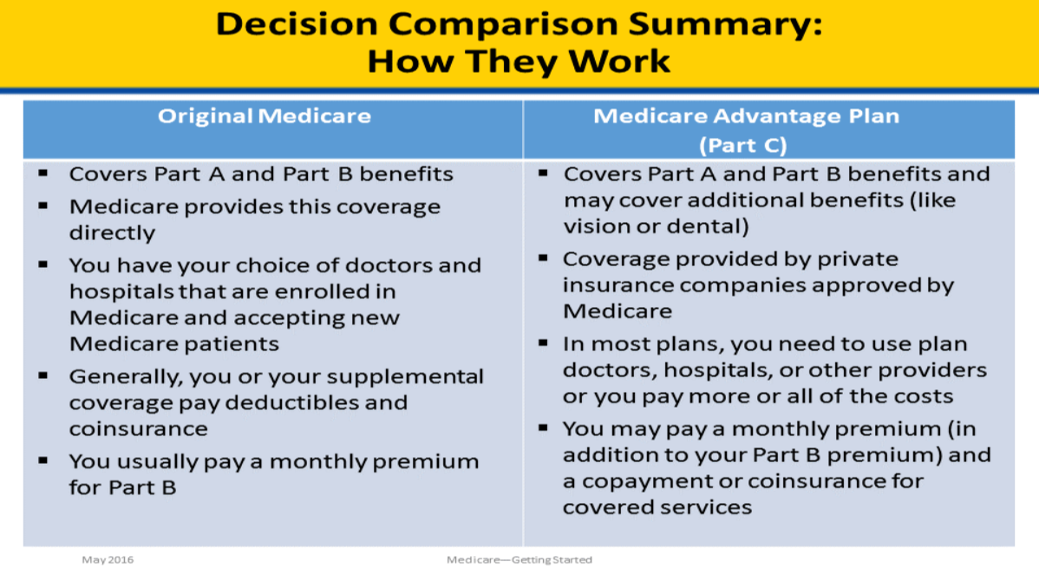
Original Medicare vs. Medicare Advantage Plans

Slide 30
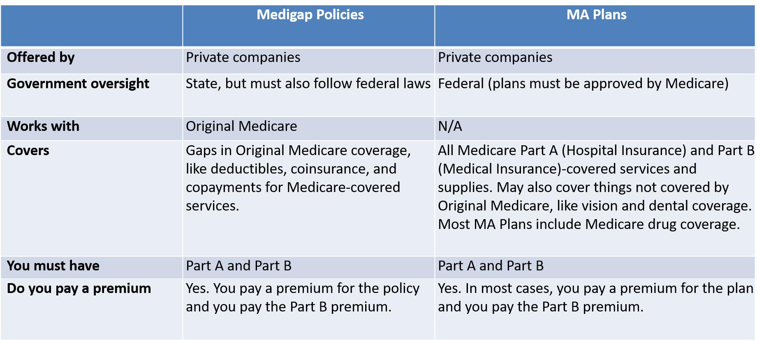
Differences between Medigap Plans and Medicare Advantage Plans

Slide 31
Medicaid and Medicare Savings Programs
Assistance is available for people with limited incomes and resources/assets
Eligibility is determined by the county Department of Social Services (DSS) in
which the person resides
In addition to full Medicaid, there are three Medicare Savings Programs (MSPs)
with different levels of assistance - for those who are eligible for Medicare, who
do not meet the full Medicaid income and resources/assets requirements (QMB,
SLMB, and QI-1)
For the Medicare Savings Programs, income determines the level of assistance
Assets/resource limits are the same for all three levels
Can reduce or eliminate monthly Part A and Part B premiums, deductibles, and
coinsurance amounts
Automatic eligibility for Extra Help for any level of Medicaid or MSP

Slide 32



Does Medicare Cover Preventive Care?

Slide 33
Medicare Drug Price Negotiation Program
Created by the Inflation Reduction Act and empowers the government to negotiate lower prices for certain high-cost, single source drugs covered by Medicare Parts B & D
Negotiated drugs for 2026
Eliquis
Enbrel
Entresto
Farxiga
Fiasp, Fiasp Flex Touch, Fiasp PenFill, NovoLog FlexPen and NovoLog PenFill
Imbruvica
Januvia
Jardiance
Stelara
Xarelto
Notes:
Legislation has been in place since 2023 with full implementation in 2029.
Capped insulin at $35.00
Caps out-of-pocket limit for outpatient Part D drugs each year.
Expanded eligibility for Extra Help Program
Reduced costs and expanded coverage for vaccines covered under Medicare
Introduced Medicare Drug Price Negotiation Program

Slide 34

NC Senior Medicare Patrol (NCSMP) Program
The goal of the NCSMP program is to empower all Medicare beneficiaries to prevent health care fraud, waste and abuse through education and outreach. NCSMP counselors are comprised of retired professionals, senior citizens and partnering human service agencies staff. Their mission is to provide education about Medicare error(s), fraud, waste and abuse.
All SHIIP counselors are cross-trained NCSMP counselors.

Slide 35
NC Senior Medicare Patrol (NCSMP) Program
$60 billion is lost each year to Medicare fraud nationally
PROTECT yourself against Medicare fraud
DETECT potential Medicare fraud, errors and abuse
REPORT suspected Medicare fraud, errors and abuse
to NCSMP at 855-408-1212

Slide 36
Medicare.gov
When you visit Medicare.gov, you will be able to:
  Find information about Medicare health and drug Plans in your area,
  including what they cost and the services they provide
  Find Medicare-participating doctors and/or other healthcare providers and suppliers
  See the benefits and services covered by Medicare, including preventive services
  Find Medicare Appeals information and forms
  Find information about the quality of care provided by Plans, nursing homes,
  hospitals, doctors, home health agencies, dialysis facilities, hospice providers,
  inpatient rehabilitation facilities and long-term care hospitals
  Find additional resources, including important and helpful websites and phone
  numbers
Notes:
Preventive services are notated in the Medicare & You handbook with a blue apple.

Slide 37
Medicare.gov Account
If you create a Medicare.gov account, you will be able to:
  Add your current prescriptions and pharmacies in your area to help you better compare health and drug Plans
  Sign up to go paperless – receive your yearly “Medicare and You” handbook
  and Medicare Summary Notices (MSNs) electronically
  View your Original Medicare (Part A and Part B) claims as soon as they are
  processed
  Print a copy of your Original Medicare card
  See a calendar of preventive services that you are eligible to receive under
  Original Medicare (Part B)
  Learn about your Medicare premiums and pay them online if you receive a
  statement
Notes:
You will need certain information to create a Medicare.gov account:
- MBI (Medicare number)
Effective dates found on your Medicare card
Active email address
Requires MFA (multi-factor authorization)

Slide 38


Interested in Becoming a SHIIP Volunteer?
We would LOVE to have you as a member of our SHIIP Crew!
Contact your county’s SHIIP Coordinating Site
Notes:
A list of county SHIIP coordinating sites can be found on the www.ncshiip.com website under Find Local SHIIP Help.

Slide 39
Where Can You Get Help?
Seniors’ Health Insurance Information Program (SHIIP) and
North Carolina Senior Medicare Patrol (NCSMP)
  855-408-1212 (toll free) Monday through Friday, 8 AM until 5 PM
  www.ncshiip.com
Medicare
  800-633-4227 (nationwide, toll free) 24 hours/day, 7 days/week
  www.medicare.gov
Social Security Administration
  800-772-1213 (nationwide, toll free) Monday through Friday, 8 AM until 7 PM
  www.ssa.gov or contact your local office: https://secure.ssa.gov/ICON/main.jsp

Slide 40
Where Can You Get Help?
“Medicare and You” Handbook
Remember, this is the owner’s manual for people who are on Medicare!

Slide 41

Questions?
Contact SHIIP and NCSMP
855-408-1212
(Monday through Friday, 8:00 AM to 5:00 PM)
www.ncshiip.com

