Slide 1

Medicare 101
The Basics
Lisa Barker, SHIIP Northeastern Regional Manager
Jeanie Schepisi, SHIIP Field Operations Manager

Slide 2

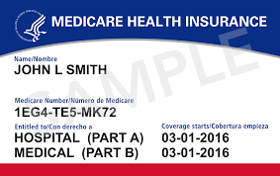
What is Medicare?

Slide 3
What is Medicare?
Federally-funded individual health insurance program that provides coverage for medically-necessary procedures, services, medical supplies and equipment.

Slide 4
Who is Eligible?
Anyone age 65 or older who participates in Social Security or the Railroad Retirement System;
Employees of Federal, State or Local Governments, or those whose spouse has participated;
Individuals under age 65 that have been awarded Social Security or Railroad Retirement Disability after 24 months;
Those disabled due to ALS (Lou Gehrig’s Disease); and
Individuals with End-Stage Renal Disease (ESRD).

Slide 5
Administration and Enrollment
Medicare is administered by the Centers for Medicare and Medicaid Services (CMS).
CMS is a branch of the Department of Health and Human Services (DHHS).
The Social Security Administration (SSA) is responsible for Medicare eligibility and enrollment.

Slide 6
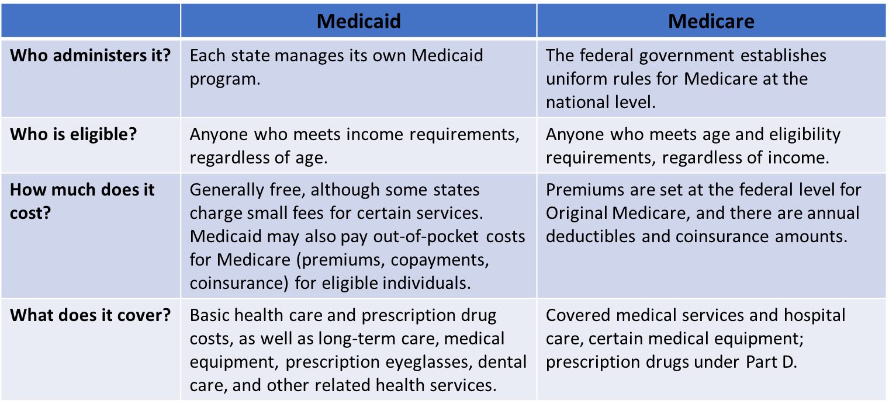
Medicaid vs. Medicare

Slide 7
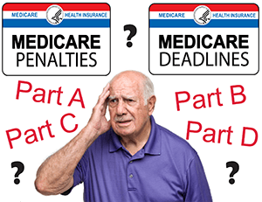
Do I Need to Enroll into Medicare Part A and Part B?

Slide 8
Automatic Enrollment
If collecting Social Security Retirement Benefits prior to age 65;
People under 65 entitled to Social Security Disability Benefits; and
  Beneficiary will receive Medicare card in the mail indicating automatic enrollment in Part A and Part B
    Beneficiary has the option to decline Part B coverage by returning the card to Social Security
  Coverage will begin the 1st day of your birth month, unless your birthday is the 1st day of the month, in which case, coverage begins the first day of the preceding month.

Slide 9
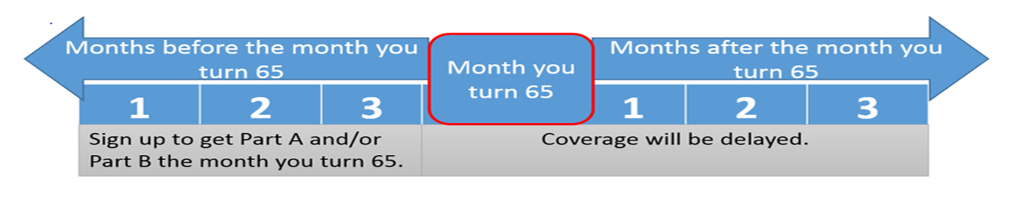
Initial Enrollment Period
If turning 65 and not collecting Social Security Retirement benefits (Automatic Enrollment);
There is a seven-month period to enroll into Medicare without penalty; and
Effective date for coverage will depend on when enrollment occurs.

Slide 10
General Enrollment Period
For those that who do not qualify for Automatic Enrollment, and who do not enroll during their Initial Enrollment Period, there is another opportunity to enroll each year.
Begins January 1st and ends March 31st
Enrollments during this period will have a delay in coverage and a late-enrollment penalty will apply.
  Coverage will not begin until July 1st
  10% Part B premium penalty, for one’s lifetime, for each 12-month period without Part B coverage
    Penalty is waived when Part B is delayed because of primary EGHP coverage

Slide 11
Special Enrollment Period
A Medicare beneficiary may be able to delay enrolling in Medicare Part B:
If they or their spouse are actively working and the employer providing the Employer Group Health Plan (EGHP):
  Has 20 or more employees (for a Medicare beneficiary aged 65 and older)
  Has 100 or more employees (for a Medicare beneficiary young than age 65/disability)
Eight-month period begins when EGHP ends or stops being primary.

Slide 12
How Do I Enroll in Medicare Part A and B?
Medicare enrollment is handled by the Social Security Administration.
  Can be completed online at www.ssa.gov;
  Call 1-800-772-1213 (Monday – Friday, 7AM -7PM); or
  Appointments can be made for local offices through the toll-free number listed above.

Slide 13
How Do I Enroll in Medicare B During COVID-19?
Due to closure of Social Security offices for face-to-face service, Medicare Part A-only beneficiaries can fax their Medicare Part applications to 833-914-2016.
Be sure to include your completed and signed CMS-40B and CMS-L564 with your fax.

Slide 14
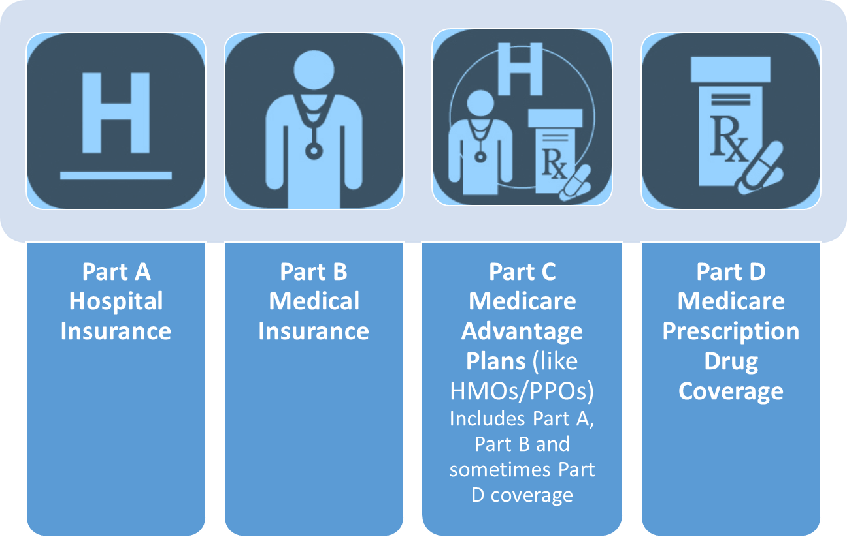
Four Parts of Medicare

Slide 15
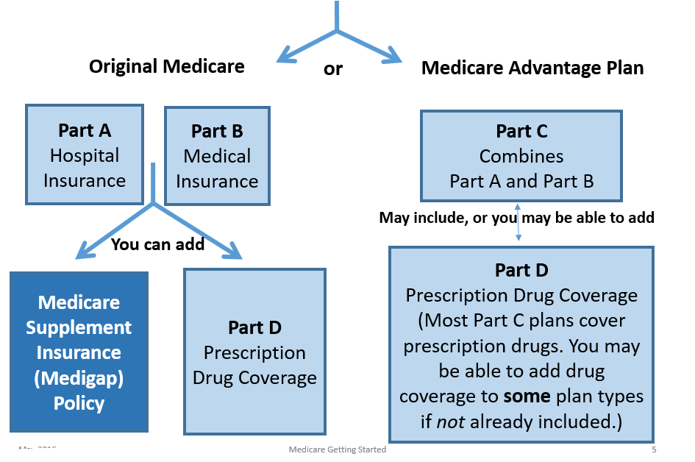
Your Medicare Coverage Choices
(there are two options)

Slide 16
Your Medicare Coverage Choices

Slide 17
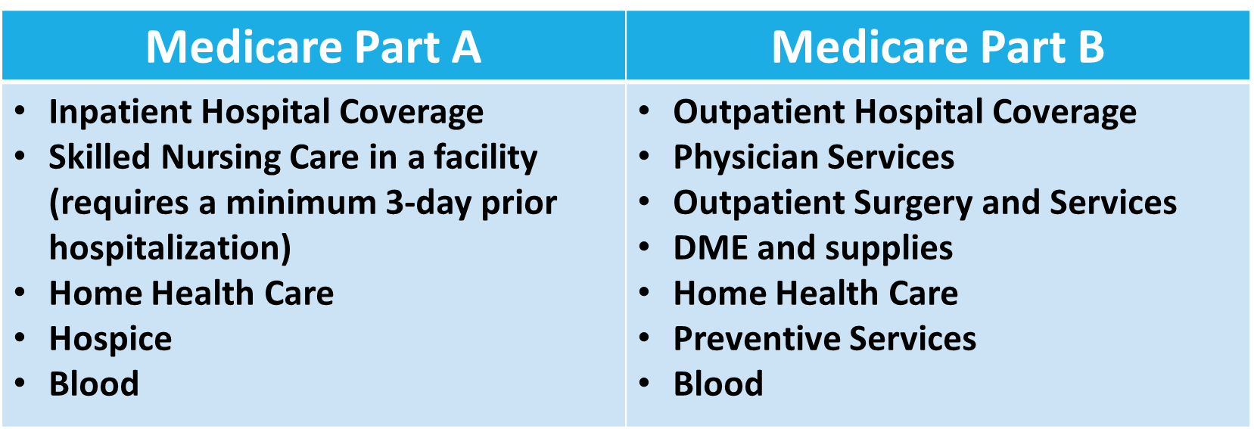
What Does Original Medicare Cover?
Medicare benefits are administered by the Centers for Medicare and Medicaid Services (CMS).

Slide 18
What Is NOT Covered by Original Medicare?
Outpatient Prescription Medications
Routine Dental Care
Routine Vision Care and Eyeglasses
Hearing Aids
Foreign Travel
Cosmetic Procedures and Treatments
Long Term Care

Slide 19
Medicare Part A and Part B

Slide 22
Medicare Supplement (Medigap Plans)
Nationally standardized insurance plans designed to fill in the “gaps” in Original Medicare coverage (deductibles, copayments, coinsurance, etc.)
Plans are designated by letters (A, B, C, D, F, G, K, L, M, N).
  Plans C, F, and F-Prime are only available to individuals who were eligible for Medicare prior to January 1, 2020.
All plans cover a basic group of benefits, with plans each covering a different group of benefits
Coverage is the same from company to company, but premiums do vary
This presentation does not address how Medicare works with other insurance coverage, such as EGHP, COBRA, TriCare or VA benefits.

Slide 23
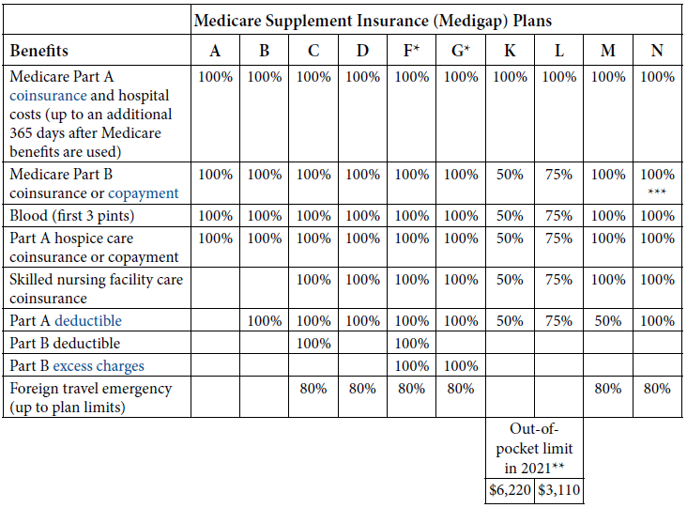

Slide 24
Medicare Prescription Drug Coverage – Part D
Anyone covered by Medicare Part A and/or Part B is eligible to purchase a Part D plan.
Plans are sold by private insurance companies, that are contracted with CMS, and require payment of monthly premiums.
Each plan covers a group of prescription medications (formulary).
  Annual deductible may need to be satisfied
  Copayments apply to prescription medications
Plans and formularies may change annually.
  Compare your Medicare Part D plan each year during the Medicare OEP

Slide 25
When Can I Enroll into a Part D Plan?
During your seven-month Initial Enrollment Period (IEP)
During the annual Medicare Open Enrollment Period (OEP)
  October 15th – December 7th each year
  Coverage begins on January 1st
May be able to join at other times
  Annual Medicare Advantage Open Enrollment Period (MAOEP)
    January 1st – March 31st each year
  Special Enrollment Period (SEP)
    You must qualify for an SEP (i.e. qualifying for Extra Help)

Slide 26
Part D – Extra Help Program
Financial assistance is available for people with limited income and resources/assets.
Eligibility is determined by the Social Security Administration.
Can reduce or eliminate monthly premiums, reduce prescription drug copayments, and provide a quarterly SEP to make a change to another plan.
Quarterly changes are available only during the first three quarters of the calendar year.
  January 1st – March 31st
  April 1st – June 30th
  July 1st – September 30th

Slide 27
Your Medicare Coverage Choices

Slide 28
Medicare Advantage Plans (Part C)
Health Plan options approved by Medicare
  Another way to et your Medicare coverage
  Still part of the Medicare Program
  Offered by private companies who are contracted with CMS
Medicare pays the plan an amount for each member’s care
May have to use network healthcare providers (doctors, hospitals etc.) – ALWAYS check with your healthcare providers
Types of plans available vary from county to county
There is an additional opportunity to change Medicare Advantage Plans
  January 1st – March 31st (MAOEP)

Slide 29
When and How Can You Enroll into a Medicare Advantage Plan?
During your Initial Enrollment Period;
During the annual Medicare Open Enrollment Period (October 15th – December 7th each year) ;
During the Medicare Advantage Open Enrollment Period (January 1st - March 31st each year); and
Based on a Special Enrollment Period, but you must qualify.
  Moving to a different county or state
  Qualifying for Extra Help

Slide 30
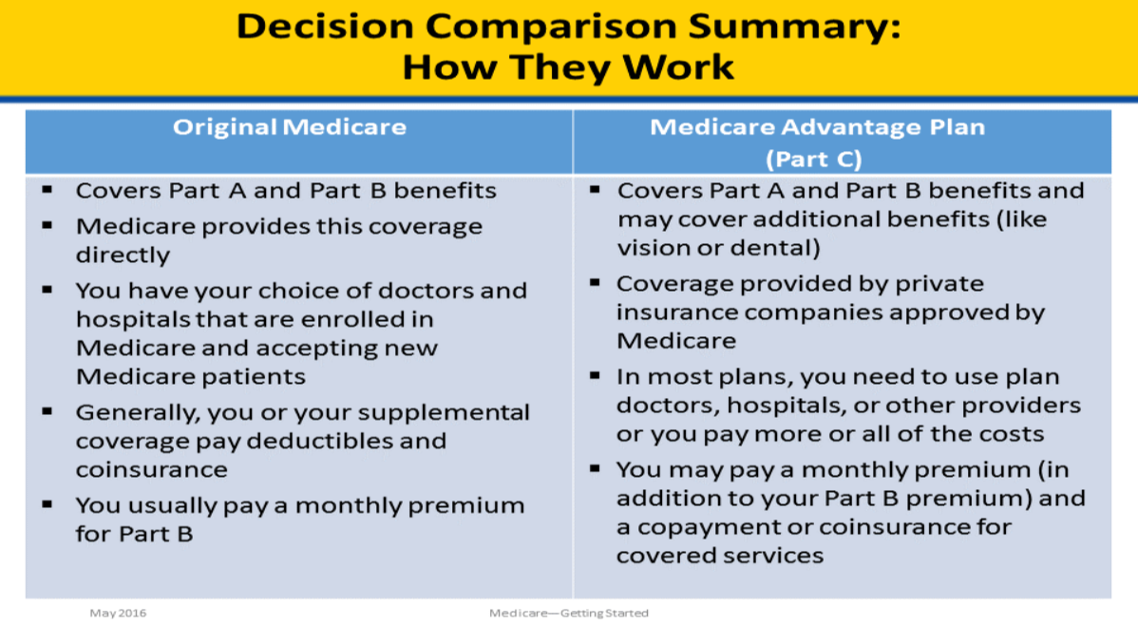
Original Medicare vs. Medicare Advantage Plans

Slide 31
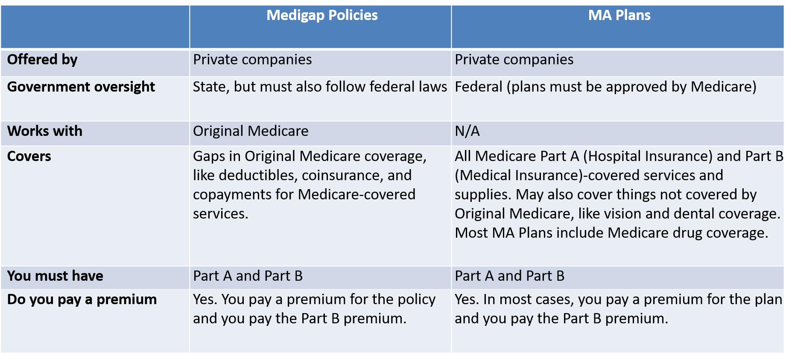
Differences between Medigap Plans and Medicare Advantage Plans

Slide 32
Medicare Savings Programs
Financial assistance is available for people with limited income and resources/assets.
Eligibility is determined by the county Department of Social Services (DSS) agency.
There are three levels of assistance; QMB, SLMB, and QI-1
  Income determines the level of assistance
Asset/resource limits are the same for all three levels
Can reduce or eliminate monthly Part A and Part B premiums, deductibles, and coinsurance amount
Automatic eligibility for Extra Help

Slide 33



Does Medicare Cover Preventive Care?

Slide 34

NC Senior Medicare Patrol (NCSMP) Program
The goal of the NCSMP program is to empower all Medicare beneficiaries to prevent health care fraud, waste and abuse through education and outreach. NCSMP Counselors are comprised of retired professionals, senior citizens and partnering human service agencies staff. Their mission is to provide education about Medicare error(s), fraud, waste and abuse.
All SHIIP Counselors are cross trained to be NCSMP Counselors. Their goal is to educate beneficiaries within their communities to protect, detect and report Medicare fraud, waste and abuse.

Slide 35
NC Senior Medicare Patrol (NCSMP) Program
$68 billion is lost each year to Medicare fraud nationally
Protect yourself against Medicare fraud
Detect potential Medicare fraud, errors and abuse
Report suspected Medicare fraud, errors and abuse
to NCSMP at 855-408-1212

Slide 36
Medicare.gov
When you visit Medicare.gov, you will be able to:
  Find information about Medicare health and drug plans in your area, including the cost and the services provided;
  Find Medicare-participating doctors and/or other healthcare providers and suppliers;
  See the benefits and services covered by Medicare including preventive services;
  Find Medicare appeals information and forms;
  Find information about the quality of care provided by plans, nursing homes, hospitals, doctors, home health agencies, dialysis facilities, hospice providers, inpatient rehabilitation facilities and long-term care hospitals; and
  Find additional resources including websites and phone numbers.

Slide 37
Medicare.gov Account
If you create a Medicare.gov account, you will be able to:
  Add prescriptions and pharmacies to help you better compare health and drug plans in your area;
  Sign up to go paperless – receive your yearly “Medicare and You” handbook and Medicare Summary Notices (MSNs) electronically;
  View your Original Medicare (Part A and Part B) claims as soon as they are processed;
  Print a copy of your Original Medicare card;
  See a calendar of preventive services that you are eligible to receive under Original Medicare (Part B); and
  Learn about your Medicare premiums and pay them online if you receive a statement.

Slide 38


Interested in Becoming a SHIIP Volunteer?

Slide 39
Where Can You Get Help?
Seniors’ Health Insurance Information Program (SHIIP)/
North Carolina Senior Medicare Patrol (NCSMP)
  855-408-1212 (toll-free)
  www.ncshiip.com
Medicare
  800-633-4227 (toll-free)
  www.medicare.gov
Social Security Administration
  800-772-1213 (toll-free)
  www.ssa.gov

Slide 40
Where Can You Get Help?
“Medicare and You” Handbook
Remember, this is the owner’s manual for people on Medicare!

Slide 41

Questions?
Contact SHIIP and NCSMP
855-408-1212
(Monday – Friday 8:00 AM to 5:00 PM)
www.ncshiip.com
ncshiip@ncdoi.gov

